Slide 1

6th Grade Math
Unit 11, Lesson 3 Evaluating Algebraic Expressions Using Substitution Volume 2, pg. 251

Slide 2


Benchmark
MA.6.AR.1.3
Evaluate algebraic expressions using substitution and order of operations.
volume 2, pg. 251

Slide 3
Integrated Mathematical Thinking and Reasoning Standards
MA.K12.MTR.4.1
Engage in discussions that reflect on the mathematical thinking of self and others.
MA.K12.MTR.5.1
Use patterns and structure to help understand and connect mathematical concepts.
volume 2, pg. 251

Slide 4

Learning Target
I can evaluate algebraic expressions using substitution.
volume 2, pg. 251

Slide 5

Warm-Up
volume 2, pg. 252

Slide 6
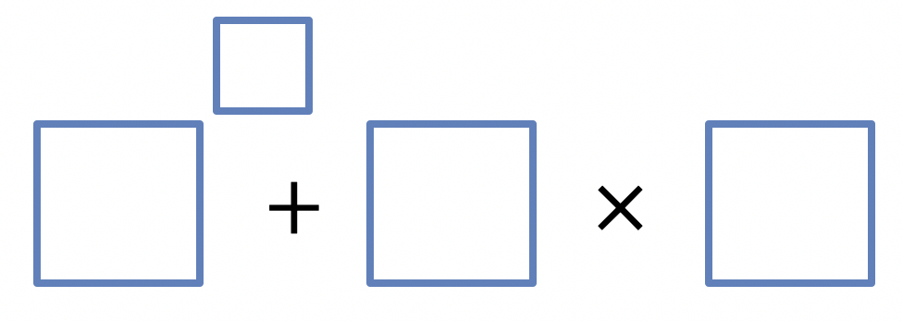
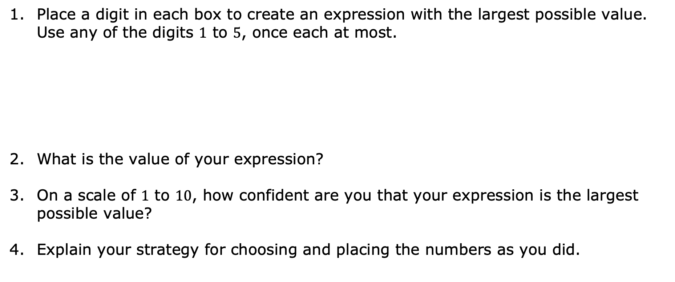
11.3.1 Warm-Up: Order Explorer
Place a digit in each box to create an expression with the largest possible value. Use any of the digits $1$ to $5$, once each at most.
What is the value of your expression?
On a scale of $1$ to $10$, how confident are you that your expression is the largest possible value?
Explain your strategy for choosing and placing the numbers as you did.
volume 2, pg. 252

Slide 7

Collaboration
volume 2, pg. 252

Slide 8

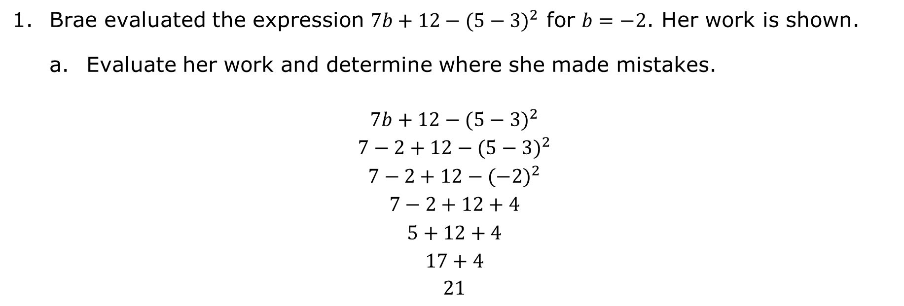
11.3.2 Collaboration: Evaluating Algebraic Expressions by Substituting Integers
Brae evaluated the expression $7b+12−{(5−3)}^{2}$ for $b=−2$. Her work is shown.
Evaluate her work and determine where she made mistakes.
$$7b+12−{(5−3)}^{2}$$
$$7−2+12−{(5−3)}^{2}$$
$$7−2+12−{(−2)}^{2}$$
$$7−2+12+4$$
$$5+12+4$$
$$17+4$$
$21$
volume 2, pg. 252

Slide 9
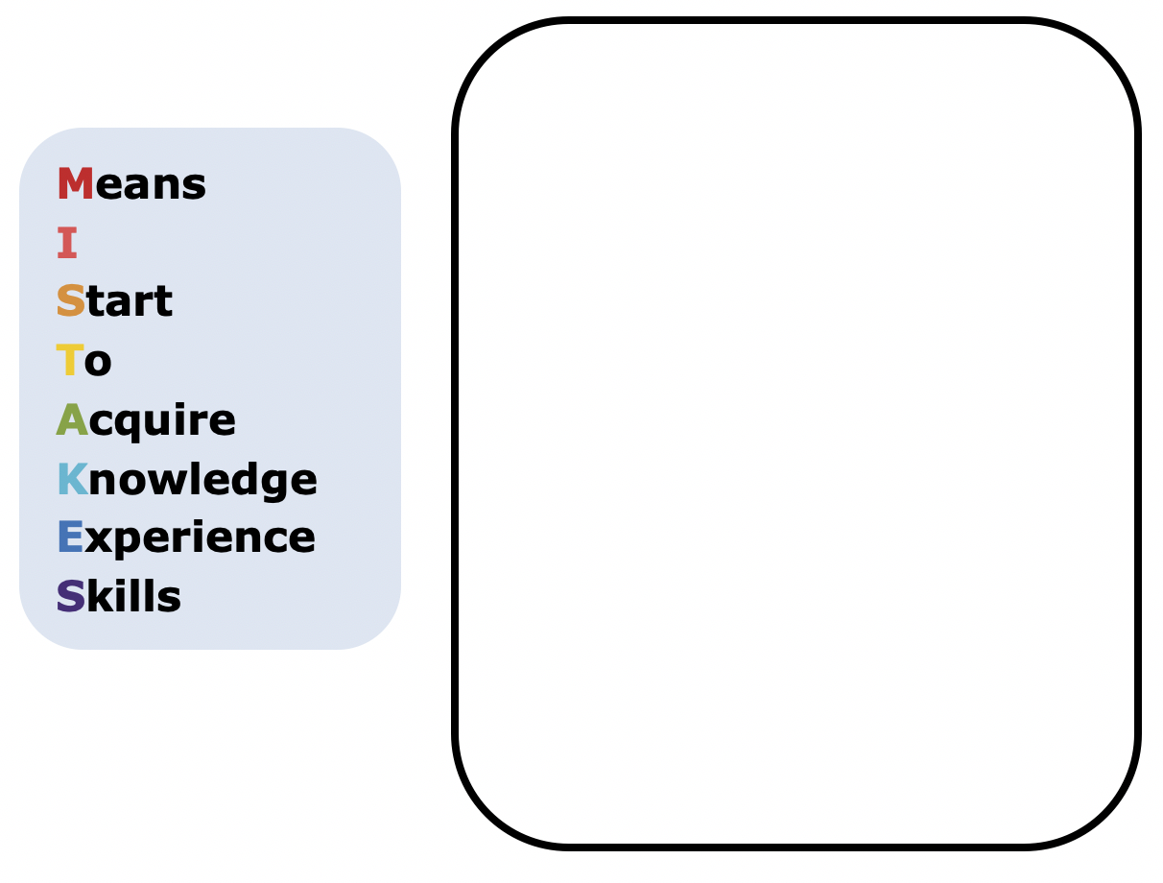
Help Brae understand and learn from her mistakes. Write a brief note to Brae explaining what her mistakes were and how she could learn from the mistakes.
volume 2, pg. 252

Slide 10
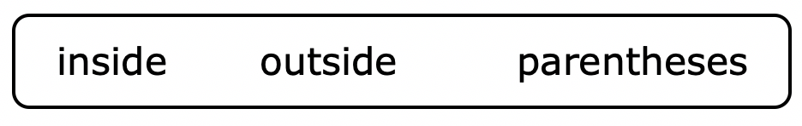
Read the note your partner wrote and offer suggestions on ways to improve their note.
Using the word bank below, complete the three reminders that could help Brae.
When substituting values into algebraic expressions, it is helpful to put the substituted value(s) in ____________.
When evaluating expressions with exponents, if the negative is _________ the parentheses, the negative indicates subtraction, or the opposite of the value found by raising the value inside to a power.
If the negative is ________ the parentheses, it indicates that the number is a negative number being raised to a power.
volume 2, pg. 253

Slide 11
Verify your answers with your partner and, if necessary, resolve any differences.
volume 2, pg. 253

Slide 12
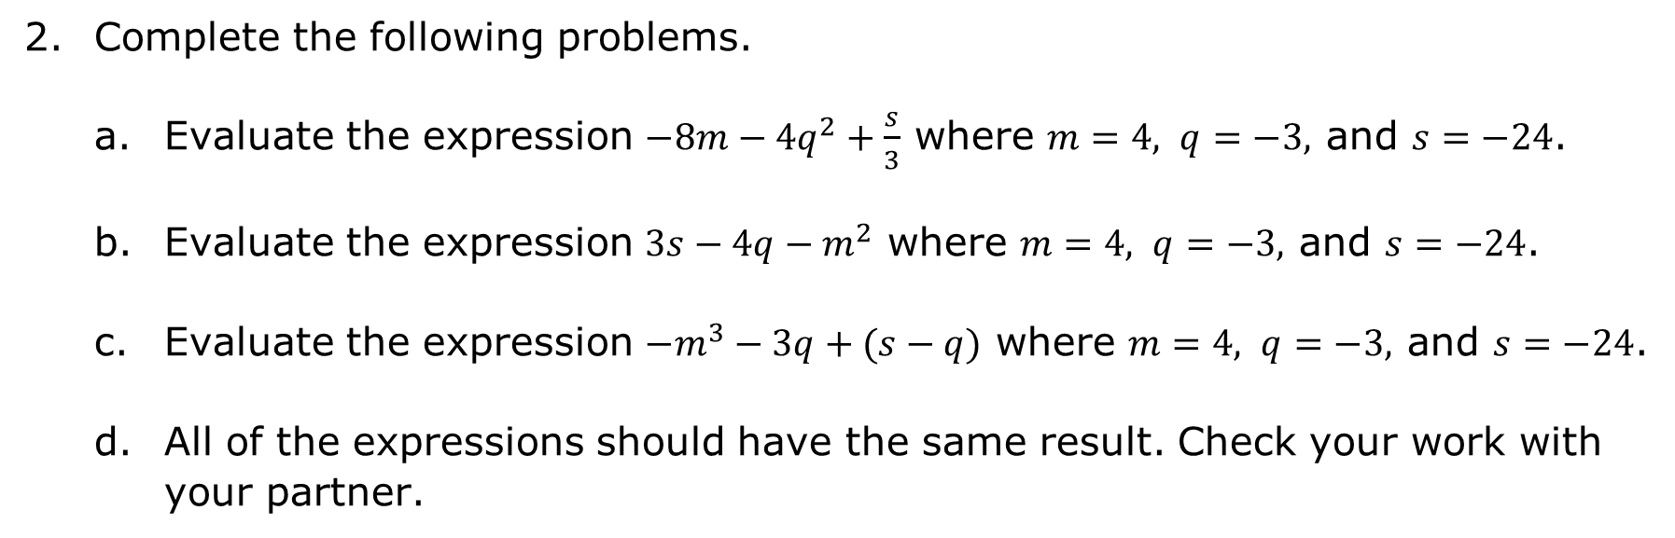
Complete the following problems.
Evaluate the expression $−8m−4q^{2}+\frac{s}{3}$ where $m=4, q=−3,$ and $s=−24$.
Evaluate the expression $3s−4q−m^{2}$ where $m=4, q=−3,$ and $s=−24$.
Evaluate the expression $−m^{3}−3q+(s−q)$ where $m=4, q=−3,$ and $s=−24$.
All of the expressions should have the same result. Check your work with your partner.
volume 2, pg. 253

Slide 13

Your Turn
volume 2, pg. 254

Slide 14
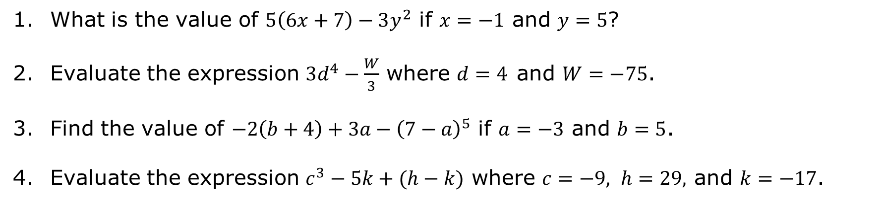
11.3.3 Your Turn!
What is the value of $5\left(6x+7\right)−3y^{2}$ if $x=−1$ and $y=5$?
Evaluate the expression $3d^{4}−\frac{W}{3}$ where $d=4$and $W=−75$.
Find the value of $−2\left(b+4\right)+3a−{\left(7−a\right)}^{5}$ if $a=−3$ and $b=5$.
Evaluate the expression $c^{3}−5k+(h−k)$ where $c=−9, h=29,$ and $k=−17$.
volume 2, pg. 254

Slide 15
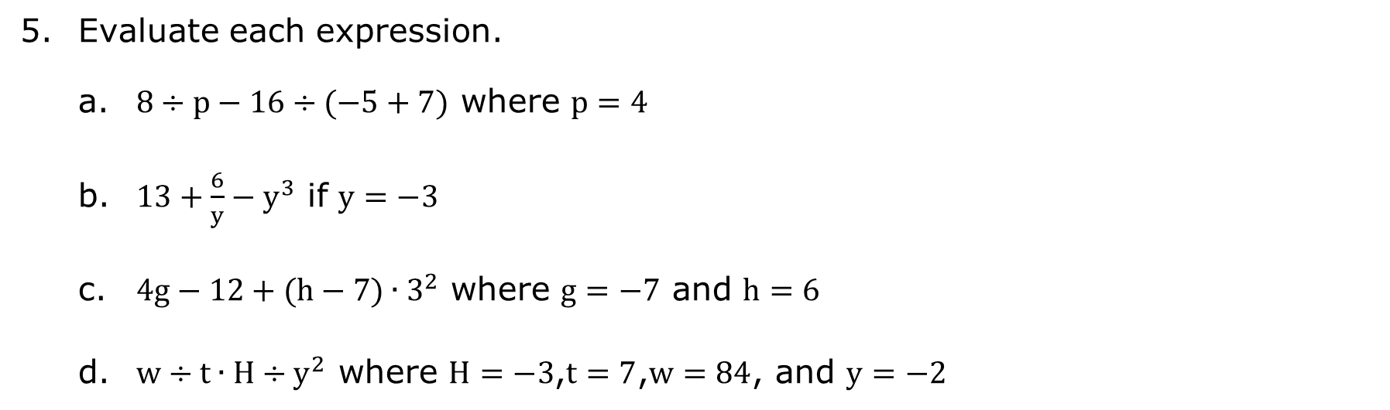
Evaluate each expression.
a. $8÷p−16÷(−5+7)$ where $p=4$
b. $13+\frac{6}{y}−y^{3}$ if $y=−3$
c. $4g−12+(h−7)∙3^{2}$ where $g=−7$ and $h=6$
d. $w÷t∙H÷y^{2}$ where $H=−3$,$t=7$,$w=84$, and $y=−2$
volume 2, pg. 254

Slide 16

Wrap-Up
volume 2, pg. 255

Slide 17
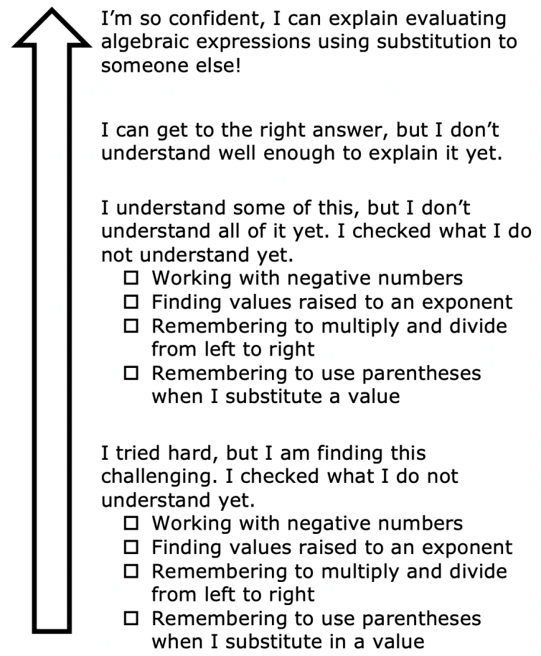
11.3.4 Wrap-Up: Reflection
Color in the arrow up to the statement that best describes your current understanding.
volume 2, pg. 255

